Slide 1
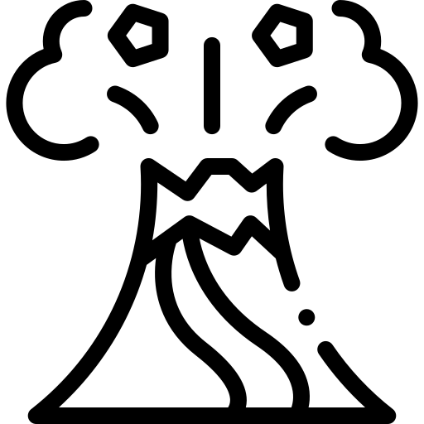

Volcanoes 101
1. What are the bottomless cauldrons said to be fueled by?
a. Hot gas
b. Ancient rock
c. Molten lava
d. Water
2. Where are most volcanoes located?
a. In deserts
b. Inside mountains
c. On tectonic plate boundaries
d. Underneath cities
3. What is the Ring of Fire?
a. A type of magma
b. A type of gas released by volcanoes
c. A volcanic eruption
d. A path tracing tectonic plate boundaries
4. Which type of volcano is characterized by a flat, dome shape?
a. Stratovolcano
b. Shield volcano
c. Caldera
d. Mid-ocean ridge
5. What is magma referred to when it reaches the Earth's surface?
a. Lava
b. Ash
c. Gas
d. Rock
6. What can pyroclastic flow include?
a. Water and ice
b. Solid rock
c. Hot gas and ash
d. Cold air
7. What scale do scientists use to measure volcanic eruptions?
a. Richter scale
b. Pressure scale
c. Temperature scale
d. Volcanic Explosivity Index (VEI)
8. How many levels are there on the VEI scale?
a. 5
b. 10
c. 8
d. Unlimited
9. What was unique about the eruption of Mount Tambora in 1815?
a. It was the smallest eruption ever recorded
b. It had a VEI measurement of 7
c. It created a new mountain
d. It occurred underwater
10. How do volcanoes contribute to making life on Earth possible?
a. By providing nutrients to soil
b. By destroying habitats
c. By creating storms
d. By cooling the climate

Slide 2
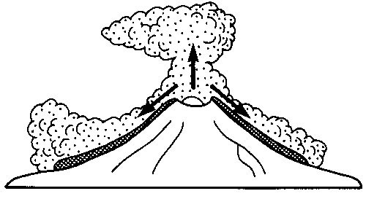
Volcanoes 101
Activity 1 - Complete the PEEL.
Point: One reason why some volcanic eruptions are more dangerous is __________________________________________
___________________________________________________________________________________________
Evidence: For example, ___________________________________________________________________________
___________________________________________________________________________________________
Explain: This shows eruptions can be more violent because __________________________________________________
___________________________________________________________________________________________
Link: This is important because it helps us understand _____________________________________________________
___________________________________________________________________________________________
Activity 2 - Add the numbers to the correct place on the diagram
Activity 3: Explain how each stage of the volcanic process makes an eruption more or less dangerous.
________________________________________________________________________________________________________________________________________________________________________________________________________________________________________________________________________________________________________________________________________________________________________________________________________________________________________________________________________________________________________________________________________________________________________________________________________________________________________________
Labels:
Destructive or Constructive boundaries
Runny or Sticky magma
Gas and Pressure build-up
Violent eruption
Ash, Dust & Rock
Pyroclastic flow

Slide 3
